Slide 1
MATLAB - Basics
Centro de Informática
Universidade Federal de Pernambuco
Aprendizagem de Máquina – IN1102
Arley Ristar – arrr2@cin.ufpe.br
Based on ES 156 Matlab Presentation - Harvard SEAS

Slide 2
Outline
Introduction
Data structure: matrices, vectors and operations
Programming
  Functions, scripts
  Programming control commands
File I/O
Basic line plots
Specialized Graphics
  Bar graph
  Pie chart
  Histogram
Convolution
Practice Problems

Slide 3
What is MATLAB
High level language for technical computing
Stands for MATrix LABoratory
Everything is a matrix - easy to do linear algebra

Slide 4
The MATLAB System
Development Environment
Mathematical Function Library
MATLAB language
Application Programming Language

Slide 5
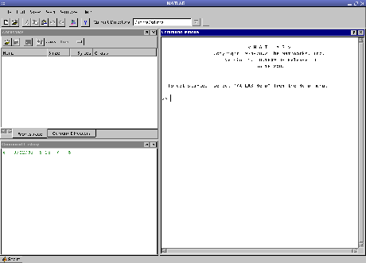
The MATLAB Desktop
Menu and toolbar
Workspace
History
Command

Slide 6
Matrices & Vectors
All (almost) entities in MATLAB are matrices
Easy to define:
Use ‘,’ or ‘ ’ to separate row elements -- use ‘;’ to separate rows
>> A = [16 3; 5 10]
A = 16 3
5 10

Slide 7
Matrices & Vectors - II
Order of Matrix -
  m=no. of rows, n=no. of columns
Vectors - special case
  n = 1 column vector
  m = 1 row vector

Slide 8
Creating Vectors and Matrices
Define
Transpose
>> A = [16 3; 5 10]
A = 16 3
5 10
>> B = [3 4 5
6 7 8]
B = 3 4 5
6 7 8
Matrix:
>> A=[1 2; 3 4];
>> A'
ans =
1 3
2 4
Vector :
>> a=[1 2 3];
>> a'
1
2
3

Slide 9
Creating Vectors
Create vector with equally spaced intervals
>> x=0:0.5:pi
x =
0 0.5000 1.0000 1.5000 2.0000 2.5000 3.0000
Create vector with n equally spaced intervals
>> x=linspace(0, pi, 7)
x =
0 0.5236 1.0472 1.5708 2.0944 2.6180 3.1416
Equal spaced intervals in logarithm space
>> x=logspace(1,2,7)
x =
10.0000 14.6780 21.5443 … 68.1292 100.0000
Note: MATLAB uses pi to represent , uses i or j to represent imaginary unit

Slide 10
Creating Matrices
zeros(m, n): matrix with all zeros
ones(m, n): matrix with all ones.
eye(m, n): the identity matrix
rand(m, n): uniformly distributed random
randn(m, n): normally distributed random
magic(m): square matrix whose elements have the same sum, along the row, column and diagonal.
pascal(m) : Pascal matrix.

Slide 11
Matrix operations
^: exponentiation
*: multiplication
/: division
\: left division. The operation A\B is effectively the same as INV(A)*B, although left division is calculated differently and is much quicker.
+: addition
-: subtraction

Slide 12
Array Operations
Evaluated element by element
    .' : array transpose (non-conjugated transpose)
    .^ : array power
    .* : array multiplication
    ./ : array division
Very different from Matrix operations
>> A=[1 2;3 4];
>> B=[5 6;7 8];
>> A*B
19 22
43 50
But:
>> A.*B
5 12
21 32

Slide 13
Some Built-in functions
mean(A):mean value of a vector
max(A), min (A): maximum and minimum.
sum(A): summation.
sort(A): sorted vector
median(A): median value
std(A): standard deviation.
det(A) : determinant of a square matrix
dot(a,b): dot product of two vectors
Cross(a,b): cross product of two vectors
Inv(A): Inverse of a matrix A

Slide 14
Indexing Matrices
Given the matrix:
Then:
  A(1,2) = 0.6068
  A(3) = 0.6068
  A(:,1) = [0.9501
  0.2311 ]
  A(1,2:3)=[0.6068 0.4231]
n
A =
0.9501 0.6068 0.4231
0.2311 0.4860 0.2774
m
1:m

Slide 15
Adding Elements to a Vector or a Matrix
>> A=1:3
A=
1 2 3
>> A(4:6)=5:2:9
A=
1 2 3 5 7 9
>> B=1:2
B=
1 2
>> B(5)=7;
B=
1 2 0 0 7
>> C=[1 2; 3 4]
C=
1 2
3 4
>> C(3,:)=[5 6];
C=
1 2
3 4
5 6
>> D=linspace(4,12,3);
>> E=[C D’]
E=
1 2 4
3 4 8
5 6 12

Slide 16
Programming in MATLAB: Scripts
Scripts have no input and output
List of commands
Variables are available on completion
Simple example
theta = -pi:0.01:pi; % Computations
rho = 2 *sin(5 *theta).^2;
polar(theta,rho) % Graphics output

Slide 17
Programming MATLAB: Functions
Writing an M-File:
function f = fact(n) definition
% FACT Factorial. help line
% FACT(N) returns the factorial of N
% usually denoted by N!
% Put simply, FACT(N) is PROD(1:N).
f = prod(1:n); % Function body
return

Slide 18
Programming in MATLAB – functions II
Functions have inputs and outputs
Variables defined in the function isn’t defined after function completes evaluating
Call a function
[out1, out2,…, outN] = functionname(in1, in2, ..., inN)
A MATLAB function is usually saved as a *.m file with the filename the same as the function name. When a function is being called, MATLAB looks for the filename.

Slide 19
Programming in MATLAB-subfunctions
An M-file can contain code for more than one function.
Additional functions within the file are called subfunctions.
Subfunctions are only visible to the primary function or to other subfunctions in the same file.
function [avg, sdv] = mystats(u) % Primary function
% mystats finds mean and standard deviation of a vector
avg=mean(u);
sdv = mysdv(u);
function a = mysdv(v) %subfunction
a=sum((u-mean(u)).^2)/(length(u)-1);
a=sqrt(a);

Slide 20
Flow control
Logic control structures:
Iterative structures:
Traditional for loop
Matlab vector for loop
If/elseif/else
switch/case/otherwise
for
while
for i=1:10
for j=1:10
a(i,j)=b(i,j)*c(i,j);
end
end
a = b.*c;

Slide 21
Try to avoid for loop
Compare the computation time of these two scripts
x=1:1e7;
s=sum(x)
x=1:1e7;
s=0;
for i=1:1e7
s=s+x(i);
end
s

Slide 22
Examples- if/else I
Construct a tri-diagonal matrix A

Slide 23
Example – if/else II
a=zeros(5,5);
for i=1:5
for j=1:5
if i==j
a(i,j)=3;
elseif abs(i-j)==1
a(i,j)=1;
end
end
end
If we write the code into a *.m file, and save it as mytridiag.m. We can execute this script in the main command window by typing
Mytridiag

Slide 24
Examples- for/while loop
You have a vector with length N-1, all the elements are distinct and belong to the set {1, 2, ……, N}. That is, one integer is not in the vector. Can you find the missing integer?
Write a function with one input (the vector) and one output (the missing integer).

Slide 25
Examples-for/while loop
function y=findmiss(x)
% x is the input, which is a N-1 vector with distinct elements in 1 to N.
% y is the output, that is not in x.
indicator=zeros(1,N);
for i=1:N-1
indicator(x(i))=1;
end
for i=1:N
if indicator(i)==0
y=i;
end
end
Save as findmiss.m
% call function findmiss
% simulate the input x
x=randperm(N);
id=ceil(rand(1)*N);
z=x(id); % z is the missing integer
% take z out of x
x=[x(1:id-1), x(id+1:end)];
y=findmiss(x)

Slide 26
Workspace
Matlab remembers old commands
And variables as well
Each Function maintains its own scope
The keyword clear removes all variables from workspace
The keyword who lists the variables

Slide 27
File I/O
Matlab has a native file format to save and load workspaces. Use keywords load and save.
In addition MATLAB knows a large number of popular formats. Type “help fileformats” for a listing.
In addition MATLAB supports ‘C’ style low level file I/O. Type “help fprintf” for more information.

Slide 28
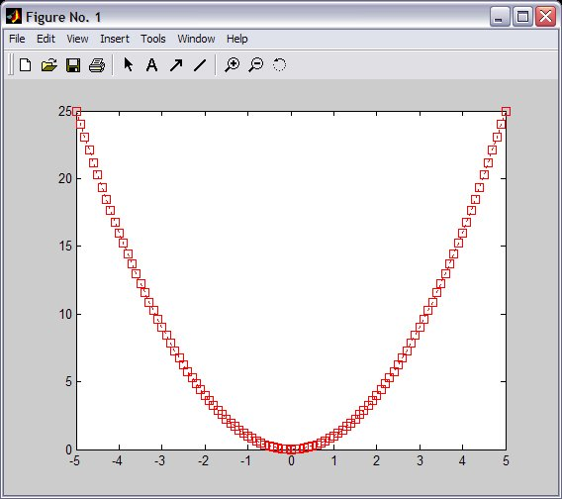
Graphics - 2D Plots
plot(xdata, ydata, ‘marker_style’);
For example: Gives:
>> x=-5:0.1:5;
>> sqr=x.^2;
>> pl1=plot(x, sqr, 'r:s');

Slide 29
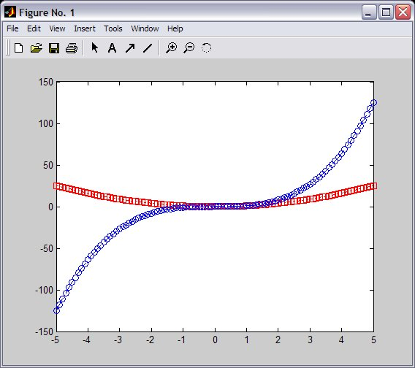
Graphics - Overlay Plots
Use hold on for overlaying graphs
So the following: Gives:
>> hold on;
>> cub=x.^3;
>> pl2=plot(x, cub,‘b-o');

Slide 30
Graphics - Annotation
Use title, xlabel, ylabel and legend for annotation
>> title('Demo plot');
>> xlabel('X Axis');
>> ylabel('Y Axis');
>> legend([pl1, pl2], 'x^2', 'x^3');

Slide 31
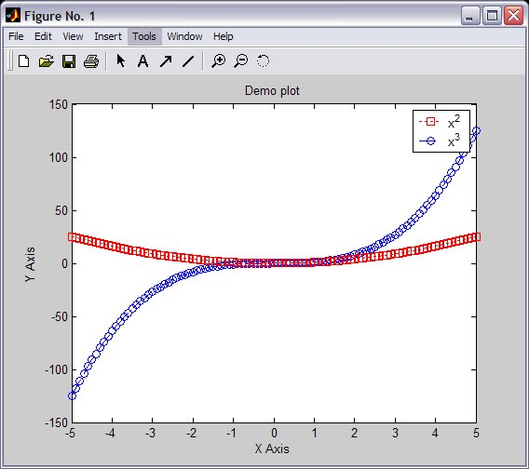
Graphics - Annotation

Slide 32
Graphics-Stem()
stem()is to plot discrete sequence data
The usage of stem() is very similar to plot()
>> n=-10:10;
>> f=stem(n,cos(n*pi/4))
>> title('cos(n\pi/4)')
>> xlabel('n')

Slide 33
Subplots
Use subplots to divide a plotting window into several panes.
>> x=0:0.1:10;
>> f=figure;
>> f1=subplot(1,2,1);
>> plot(x,cos(x),'r');
>> grid on;
>> title('Cosine')
>> f2=subplot(1,2,2);
>> plot(x,sin(x),'d');
>> grid on;
>> title('Sine');

Slide 34
Save plots
Use saveas(h,'filename.ext') to save a figure to a file.
Useful extension types:
bmp: Windows bitmap
emf: Enhanced metafile
eps: EPS Level 1
fig: MATLAB figure
jpg: JPEG image
m: MATLAB M-file
tif: TIFF image, compressed
>> f=figure;
>> x=-5:0.1:5;
>> h=plot(x,cos(2*x+pi/3));
>> title('Figure 1');
>> xlabel('x');
>> saveas(h,'figure1.fig')
>> saveas(h,'figure1.eps')

Slide 35
Bar Graphs
bar(Y) draws one bar for each element in Y
bar(x, Y) draws a bar for each element in Y at locations specified in x, where x is a monotonically increasing vector defining the x-axis
intervals for the
vertical bars.
>> x=-2:0.2:2;
>> y= exp(-x.*x)/2;
>> bar(x,y,'r')

Slide 36
Pie Charts
pie(X) draws a pie chart using the data in X. Each element in X is represented as a slice in the pie chart.
pie(X,explode) offsets a slice from the pie
>> x=[2 3 7 4];
>> subplot(2,1,1);
>> pie(x)
>> subplot(2,1,2);
>> explode=[0 0 1 0]
>> pie(x,explode)

Slide 37
Histogram
n = hist(Y,nbins) uses nbins number of equally spaced bins, and returns the number of elements in each container.
n = hist(Y,x) where
x is a vector, returns the
distribution of Y among
length(x) bins with centers
specified by x.
x = -2:0.2:2;
y =randn(10000,1);
hist(y,x);

Slide 38
Convolution
conv()
C = CONV(A, B) convolves vectors A and B. The resulting vector is LENGTH(A)+LENGTH(B)-1

Slide 39
Convolution examples
Find y[n] when
Find y[n] when h₂[n] is a rectangular function

Slide 40
Convolution – examples
Define x[n]:
Define h1[n]
n=-50:50;
x1=zeros(1,50);
n2=0:50;
x2=(0.5).^n2;
x=[x1,x2];
h1=zeros(1,51);
h1(25)=1;
Now convolve:
y1=conv(x,h1);
figure;stem(x, 'k.');
hold on; stem(y1,'r.');
axis tight;
legend('x[n]','y1[n]')

Slide 41
Convolution – examples
Define h2[n]
h2=zeros(1,51);
h2(26-5:26+5)=1;
Now convolve:
y2=conv(x,h2);
figure; subplot(2,1,1)
stem(-25:25,h2,'.');
subplot(2,1,2);
stem(-25-50:25+50,y2,'r.');

Slide 42
Practice Problems
Plot the following signals in linear scale
Plot the following signals, use log scale for y-axis
Plot the real part and imaginary part of the following signal
For the signal in previous question, plot its phase and magnitude
Use conv() to calculate and plot

Slide 43

Questions?
  Arley Ristar – arrr2@cin.ufpe.br

