Slide 1
Kinect
A brief introduction to Microsoft’s Kinect Sensor
João Marcelo Teixeira
jmxnt@cin.ufpe.br
Judith Kelner
jk@cin.ufpe.br
Tópicos Avançados em Mídia e Interação 3
http://www.cin.ufpe.br/~if760

Slide 2
Agenda
Propaganda
Current games
Example application
Real Kinect capabilities
Structured light
SDKs
How would I do it

Slide 3
Propaganda :: wow!
Controller-free gaming
Kinect responds to how you move
new type of hardware for interacting with people
Magic Disguised as Technology
Motion Sensor, Skeletal Tracking, Facial Recognition, Voice Recognition

Slide 4
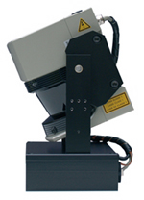
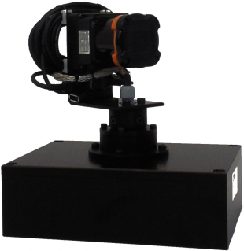
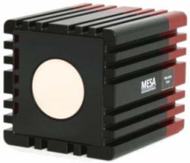
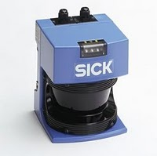
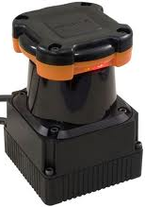
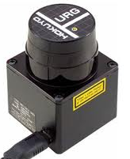
Propaganda :: prices
Description | Type | Distance | Frequency | Resolution | Price
Sick LMS200 + Tilt unit | 3D | 80m | 1,5Hz | 360 x 50 (7200) | >12.000€
Hokuyo UTM-30LX + Pan unit | 3D | 30m | 0,4Hz | 750 x 100 (75000) | >9.000€
SR4000 | 3D | 5m-10m | 54Hz | 176 x 144 (25344) | >8.000€
Sick LMS200 | 2D | 80m | 75Hz | 360 | >4.500€
Hokuyo UTM-30LX | 2D | 30m | 40Hz | 750 | ~2.800€
Hokuyo | 2D | 6,5m | 10Hz | 721 | ~850€
Kinect | 3D | 4m | 30Hz | 320 x 240 (76800) | 150€

Slide 5
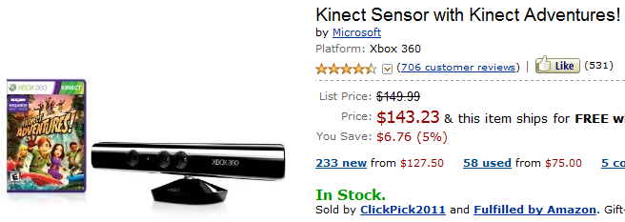
Propaganda :: prices

Slide 6
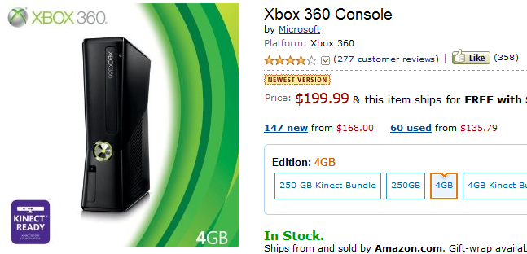
Propaganda :: prices

Slide 7
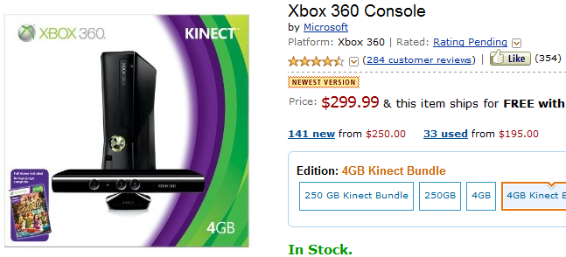
Propaganda :: prices

Slide 8
Current games :: shopto.net
31 available

Slide 9
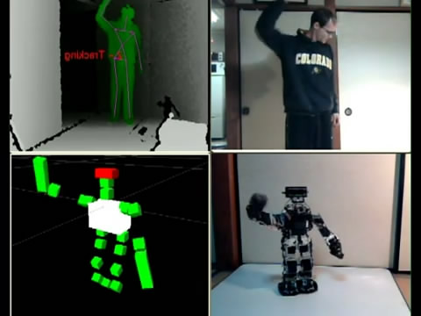
Example application :: robot control
http://www.youtube.com/watch?v=GdSfLyZl4N0

Slide 10
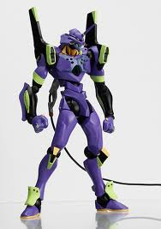
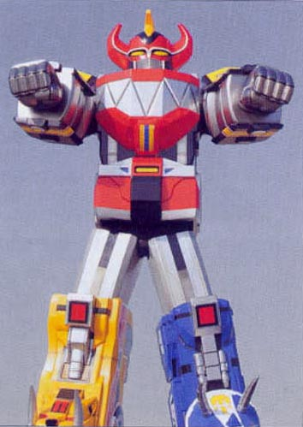
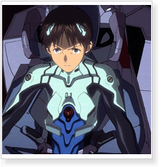
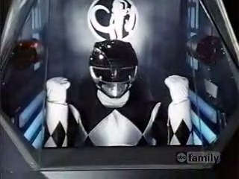
Example application :: robot control
Future possibilities?

Slide 11
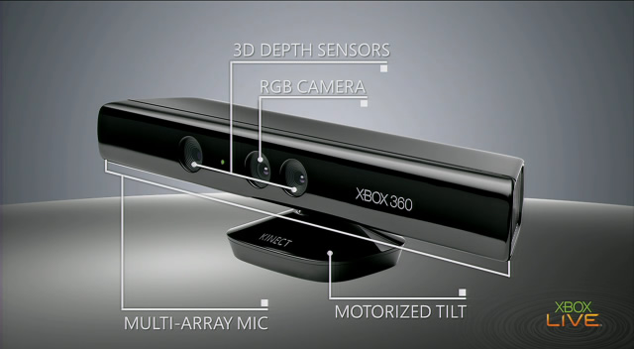
Kinect sensor demystified :: hardware

Slide 12
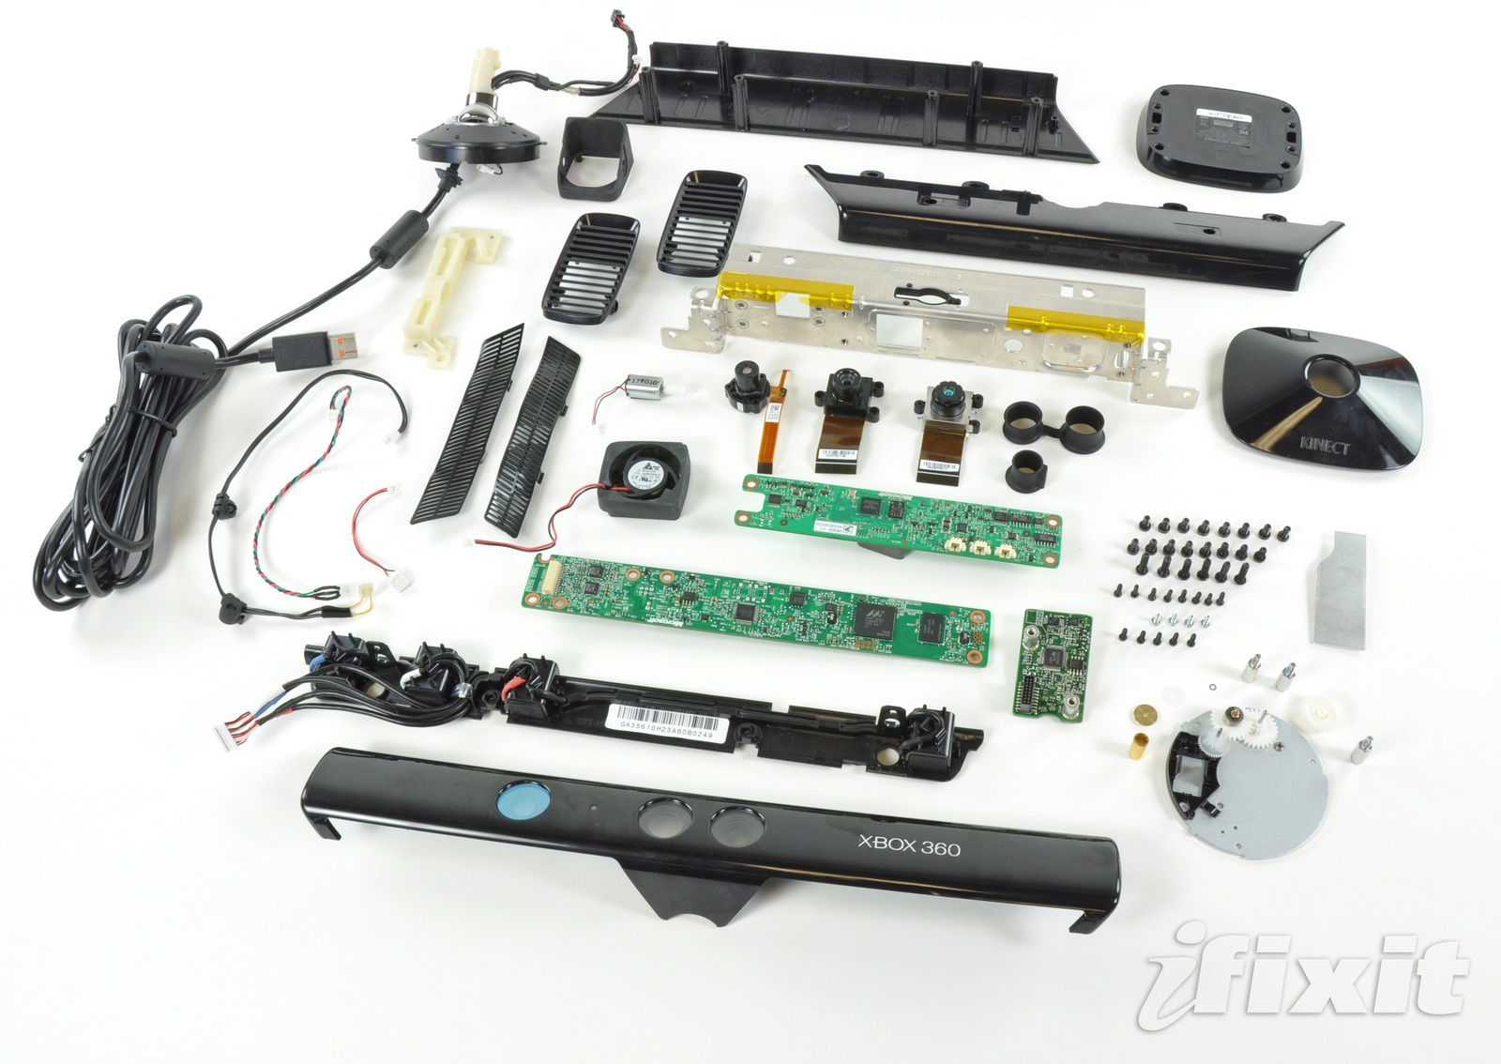
Kinect sensor demystified :: hardware

Slide 13
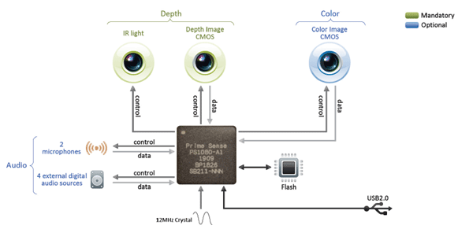
Kinect sensor demystified :: hardware
Property | Spec
Field of View (Horizontal, Vertical, Diagonal) | 58° H, 45° V, 70° D
Depth image size | VGA (640x480)
Spatial x/y resolution (@ 2m distance from sensor) | 3mm
Depth z resolution (@ 2m distance from sensor) | 1cm
Maximum image throughput (frame rate) | 60fps
Operation range | 0.8m - 3.5m
Color image size | UXGA (1600x1200)
Audio: built-in microphones | Two mics
Audio: digital inputs | Four inputs
Data interface | USB 2.0
Power supply | USB 2.0
Power consumption | 2.25W
Dimensions (Width x Height x Depth) | 14cm x 3.5cm x 5cm
Operation environment (every lighting condition) | Indoor
Operating temperature | 0°C - 40°C

Slide 14
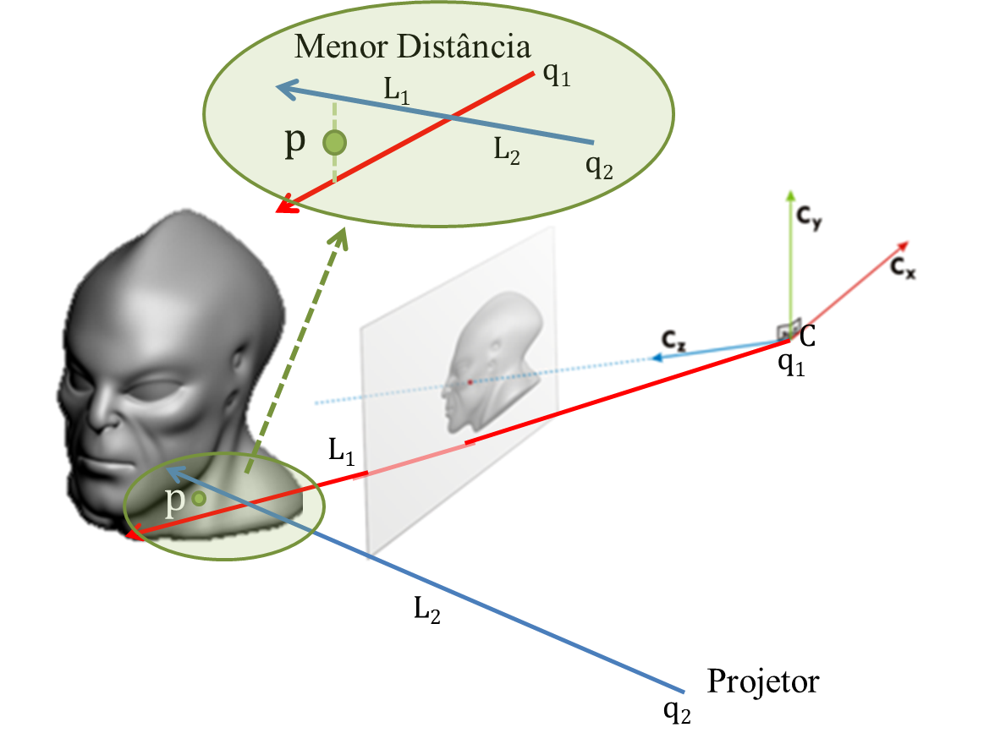
Structured light :: from 2D to 3D
Triangulation
Recovery of 3D information
Points
Through the relationship between camera and projector (2D sources)
Two possibilities
Ray x Plane intersection
Ray x Ray intersection

Slide 15
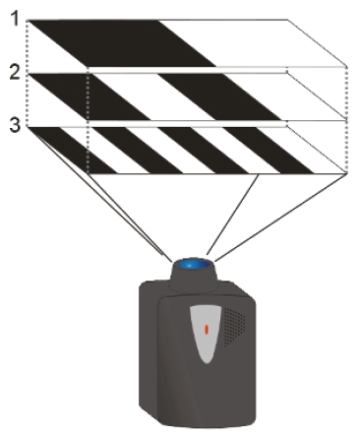
Structured light :: from 2D to 3D
Coding schemes
temporal
spacial
modulated
colored

Slide 16
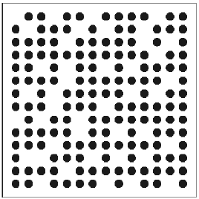
Structured light :: from 2D to 3D
Coding schemes
temporal
spacial
modulated
colored

Slide 17
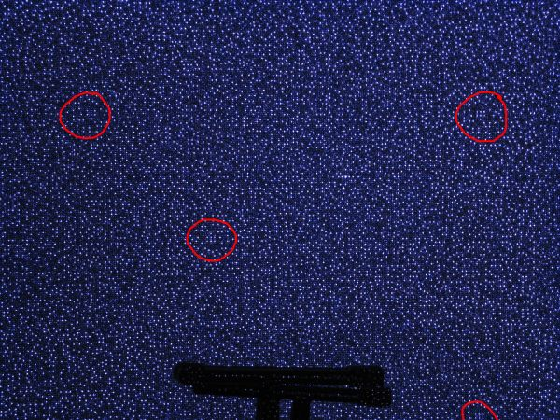

Slide 18
Structured light :: from 2D to 3D
Coding schemes
temporal
spacial
modulated
colored

Slide 19
Structured light :: from 2D to 3D
Coding schemes
temporal
spacial
modulated
colored

Slide 20
SDKs :: hacks and official
CL NUI http://codelaboratories.com/nui
OpenKinect http://openkinect.org
OpenNI http://www.openni.org
Microsoft Kinect SDK http://research.microsoft.com/kinectsdk

Slide 21
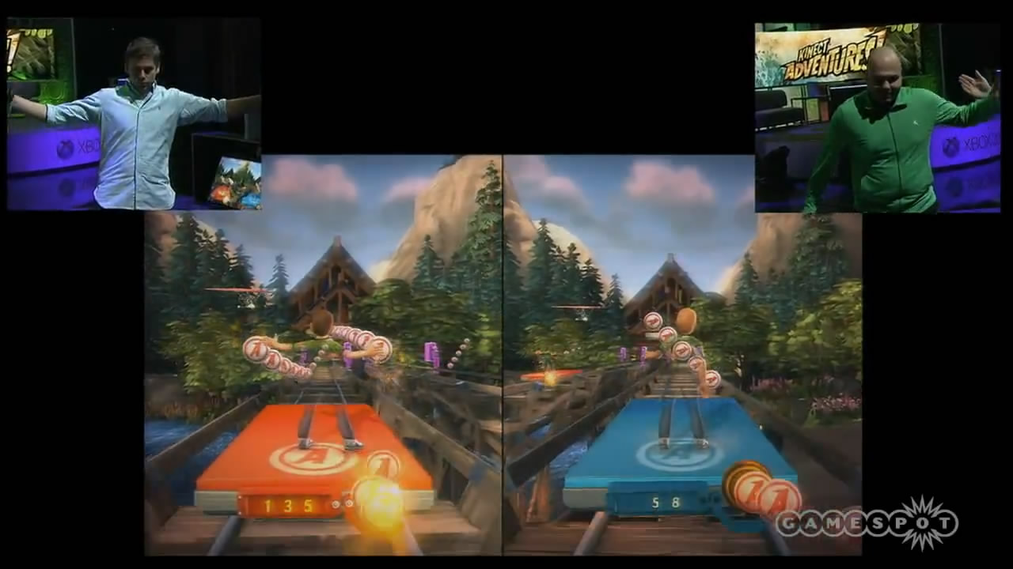
How I would do it :: Kinect Adventures
http://www.youtube.com/watch?v=xwgu7n_8RY4

Slide 22
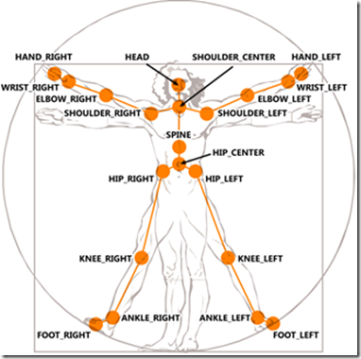
How I would do it :: Kinect Adventures
What information do we have?
RGB, Depth and Skeleton
How to do it?
Skeleton matching
Joint collision

Slide 23
How I would do it :: Kinect Adventures
Skeleton matching

Slide 24
How I would do it :: Kinect Adventures
Joint collision
.
.
.
.
.
.
.
.
.
.
.
.
.
.
.
.
.
.
.
.

Slide 25
Questions
Why a dot pattern?
Why a laser?
Why only one IR camera?
Is the dot pattern random?
How is it calibrated?
Why isn’t depth computed everywhere?
Would it work outside?

Slide 26
References
http://www.xbox.com/en-US/Kinect/Home
http://www.cs.washington.edu/education/courses/csep576/11sp/ppt/Kinect.pptx
http://www.slideshare.net/campuspartyvalencia/iniciacin-a-kinect-ppt
http://www.cs.tut.fi/~defee/mmsp/mmsp.5.ppt
http://public.csusm.edu/fangfang/Teaching/StudentNewsPresentation/Fall2010/RafaelFlores.ppt

