Slide 1
Analyzing game sessions
Túlio Caraciolo

Slide 2
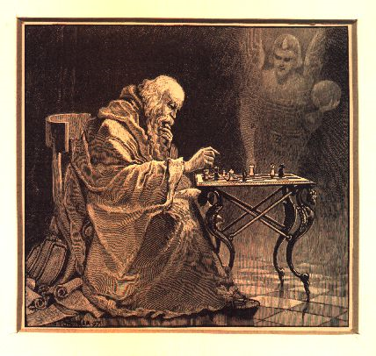
e4 c5
Nf3 d6
Bb5+ Bd7
Bxd7+ Qxd7
c4 Nc6
Nc3 Nf6
0-0 g6
d4 cxd4
Nxd4 Bg7
Nde2 Qe6
Nd5 Qxe4
Nc7+ Kd7
Nxa8 Qxc4

Slide 3
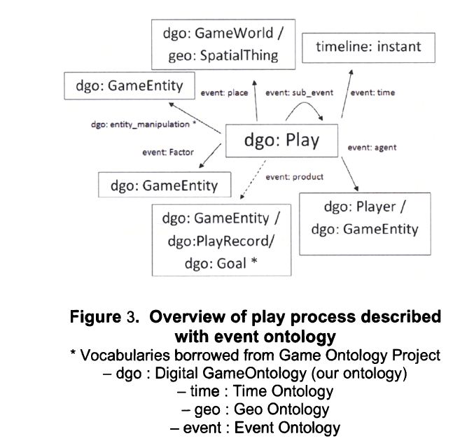

Slide 4
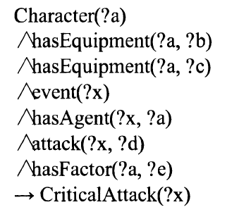
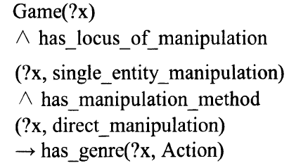
You have a character A, which, when equiped with item B and C attack enemy D with maneuver E, so a critical attack could be achieved.
If the player manipulates only one entity
and has direct control, the game is na action game.

Slide 5
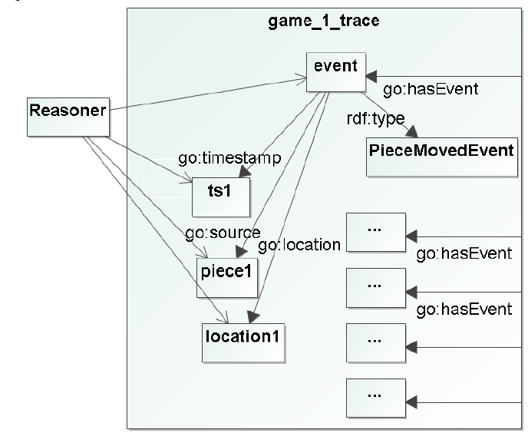

Slide 6
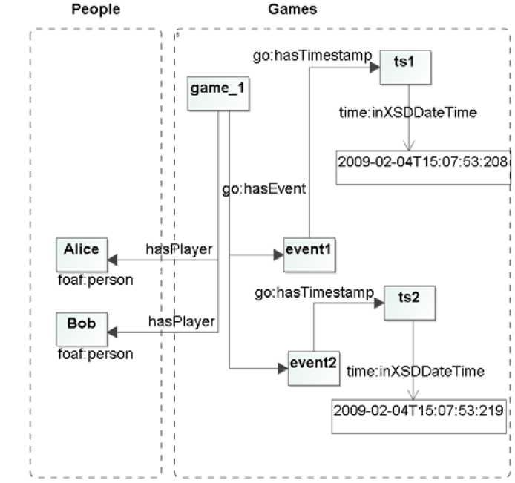

Slide 7
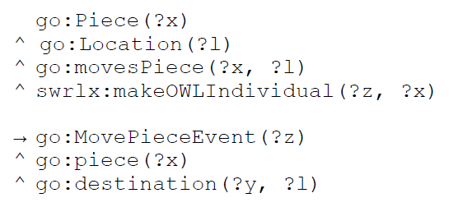
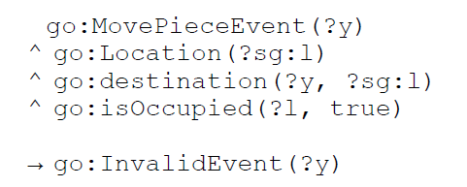
Movement of a piece, for instance, can be modeled as a change in location on the board.
A simple rule, which prohibits two pieces on the same board location might run as above.

Slide 8
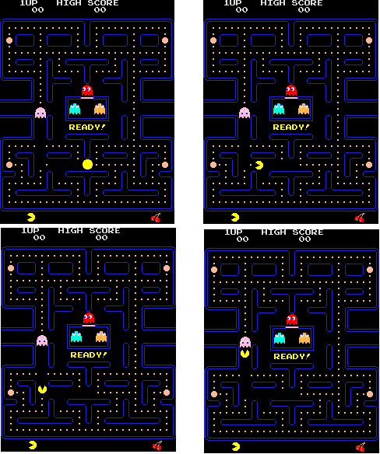
ToMove(Pacman, left)
ToRemove(Point00)
ToMove(Pacman, up)
ToColide(Pacman, Pinky)
ToRemove(Pacman)

Slide 9
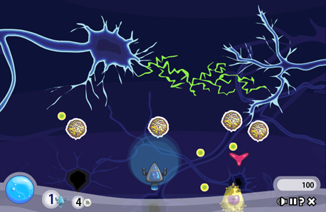

Slide 10
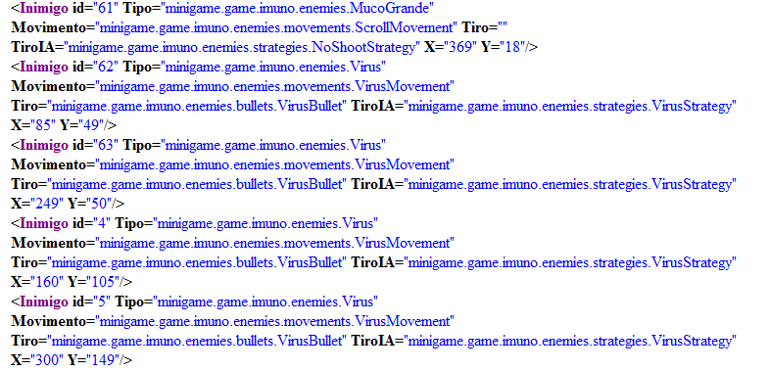
Adicionado pelo usuário

Slide 11
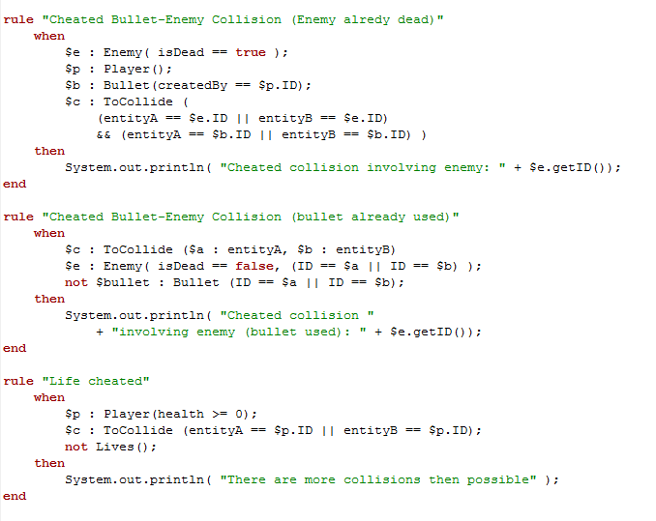

Slide 12
Conclusions
good
bad
active attacks
Attacks identified as active attacks like:
Replay
Modification of message content
non-software bugs
design bugs
usability bugs
input for data mining
passive attacks
visibility (adventures like, chave dos mundos)
clever attacks
creation of a valid log

Slide 13
Analyzing game sessions
Túlio Caraciolo

